Slide 1
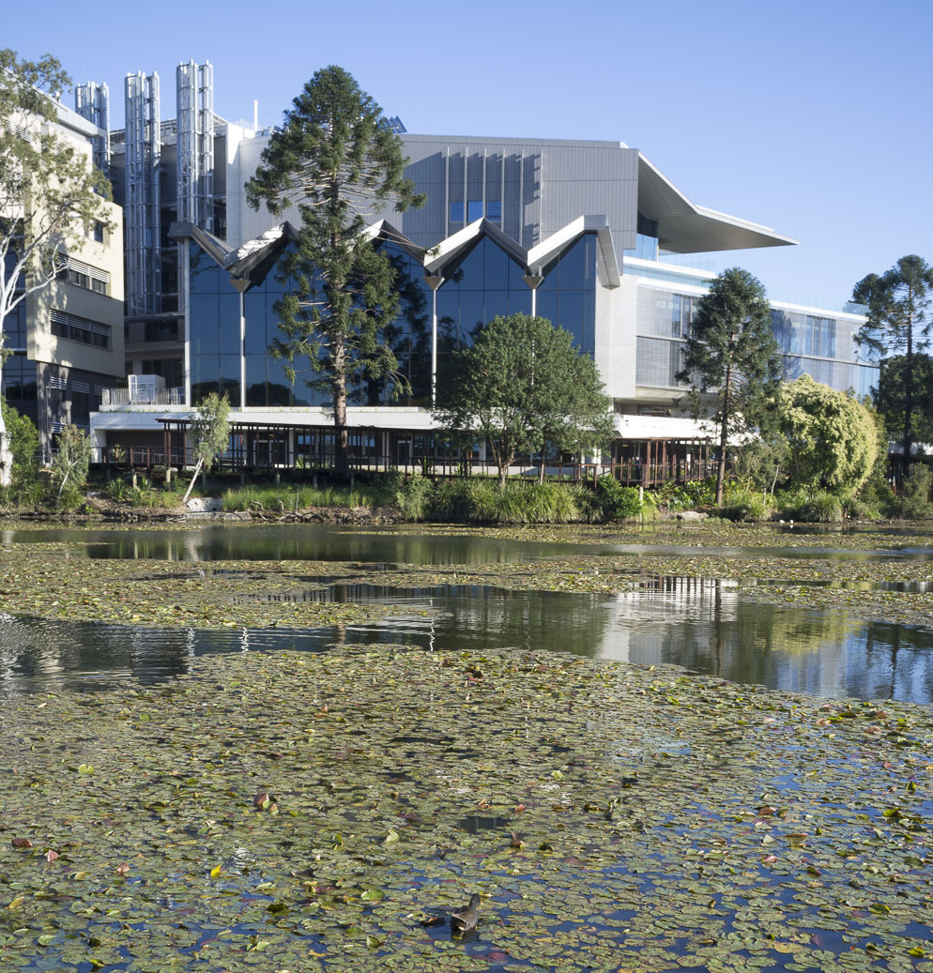
Visually accessible slides
This resource provides examples for how slides can be more visually accessible to read and take in information. It draws on:
EAIT’s Inclusive teaching, learning, and assessment practice guide and
CAST’s UDL Guidelines (2024).
Visual accessibility is one small way to embed inclusivity in your course. Refer to EAIT’s Inclusive teaching, learning, and assessment practice guide for more information on inclusive practice, universal design for learning, and different ways to implement inclusive practice in your course.
Contact the EAIT Learning Enhancement Team let@eait.uq.edu.au for individualised support and advice.

Slide 2
Example: Visually accessible fonts
Use visually accessible fonts like Verdana or Arial. Avoid fonts that are stylised, narrow, condensed, and light. These make it more difficult to read text off the page.
    The UQ lake and amphitheatre precinct, including an acoustic soundshell for performances, is open following a multi-year project to revitalise the area.
    Located between the UQ Lakes station and Advanced Engineering Building (49), the area aims to enhance the on-campus experience for students, staff and the community with spaces for cultural activities and recreation.
    The UQ Campuses on Countries Design Framework has been incorporated throughout the project with native plants and natural building materials, and the creation of outdoor places for people to gather and connect with nature.
    The UQ lake and amphitheatre precinct, including an acoustic soundshell for performances, is open following a multi-year project to revitalise the area.
    Located between the UQ Lakes station and Advanced Engineering Building (49), the area aims to enhance the on-campus experience for students, staff and the community with spaces for cultural activities and recreation.
    The UQ Campuses on Countries Design Framework has been incorporated throughout the project with native plants and natural building materials, and the creation of outdoor places for people to gather and connect with nature.
    Source: UQ lake and amphitheatre renewal

Slide 3

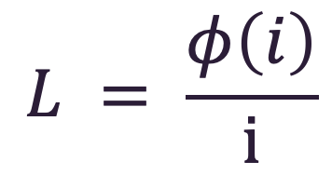
Example: Visually accessible fonts
If typesetting math in LaTeX or Mathematica, consider using Luciole Math.
$$L = \frac{φ\left(i\right)}{i}$$
Eq. 1 Using Microsoft’s Cambria Math font
Eq. 2 Using Luciole Math font

Slide 4

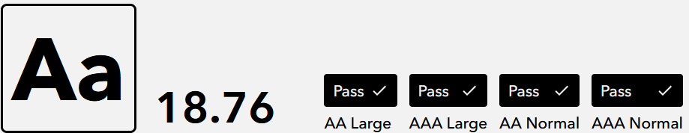
Example: Visually accessible colours
Use visually accessible colours (dark text on light background or vice versa). Use a contrast checker to test if accessible.
    More than 8,000 trees, palms and shrubs, and thousands ore wetland plants have been planted in and around the lake to form a range of habitats, increase the aesthetic appeal and create access points for the community.
    A range of sub-tropical habitats have been established to form basking areas for animals to soak up the sun, woody debris, and aquatic and terrestrial native planting.
    Floating, submerged and emergent aquatic plants will also attract a variety of insects and bugs to the lake, which will eventually provide a food source for other types of fauna including fish and birds.
    To maintain good water quality in the lake, the water should flow regularly from the main lake to the surrounding wetlands and into the Brisbane River.
    To achieve higher circulation of water, the lake area was reduced, its depth made shallower and importantly, new 0.8ha wetlands were added to its surrounds.
    Wetlands planted at the southern and northern end of the main lake connected by a narrow corridor of wetlands along the western lake edge will provide an ‘in-lake’ treatment system that filters out sediment before it enters the main lake.
Source: How UQ lake will naturally establish

Slide 5
Example: Visually accessible colours
Use colour palettes accessible for colour blindness and/or indicate differences with additional text or icons.
Source: UQ Lake aquatic fauna collection

Slide 6
Example: Visually accessible layouts
Use visually accessible layouts with headings, spacing between paragraphs, dots points lists.
New habitats for fish, turtles and eels
More than 650 native fish were relocated, including 541 long-finned eel, 87 bony bream, 16 sea mullet, 2 eel-tailed catfish, and the lungfish. A total of 251 turtles relocated were comprised of 3 different species, the main one being the Brisbane River turtle. Three suitable habitats within the Brisbane River catchment were identified for the UQ Lakes fauna – near Kholo Road bridge, Burton’s bridge, and Savages Crossing.
New habitats for fish, turtles and eels
More than 650 native fish were relocated, including:
    541 long-finned eel,
    87 bony bream,
    16 sea mullet,
    2 eel-tailed catfish, and
    the lungfish.
A total of 251 turtles relocated were comprised of 3 different species, the main one being the Brisbane River turtle.
Three suitable habitats within the Brisbane River catchment were identified for the UQ Lakes fauna – near Kholo Road bridge, Burton’s bridge, and Savages Crossing.
Source: UQ Lake aquatic fauna collection

Slide 7
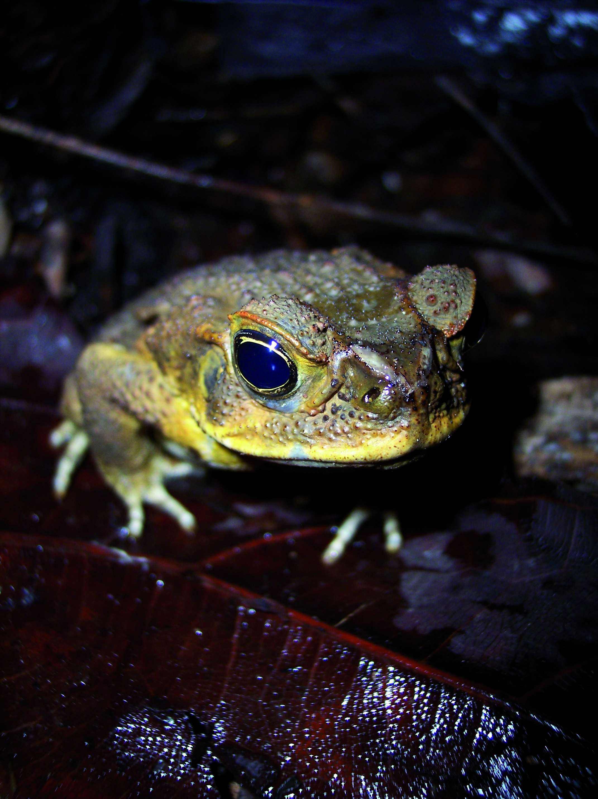
Example: Visually accessible layouts
Use visually accessible layouts with contrast between background and images.
Fig 1. Cane toad. Dark image with low contrast on dark background.
Fig 2. Cane toad. Dark image contrasted with white background.
Source: UQ Digital Asset Manager

Slide 8
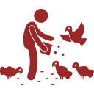



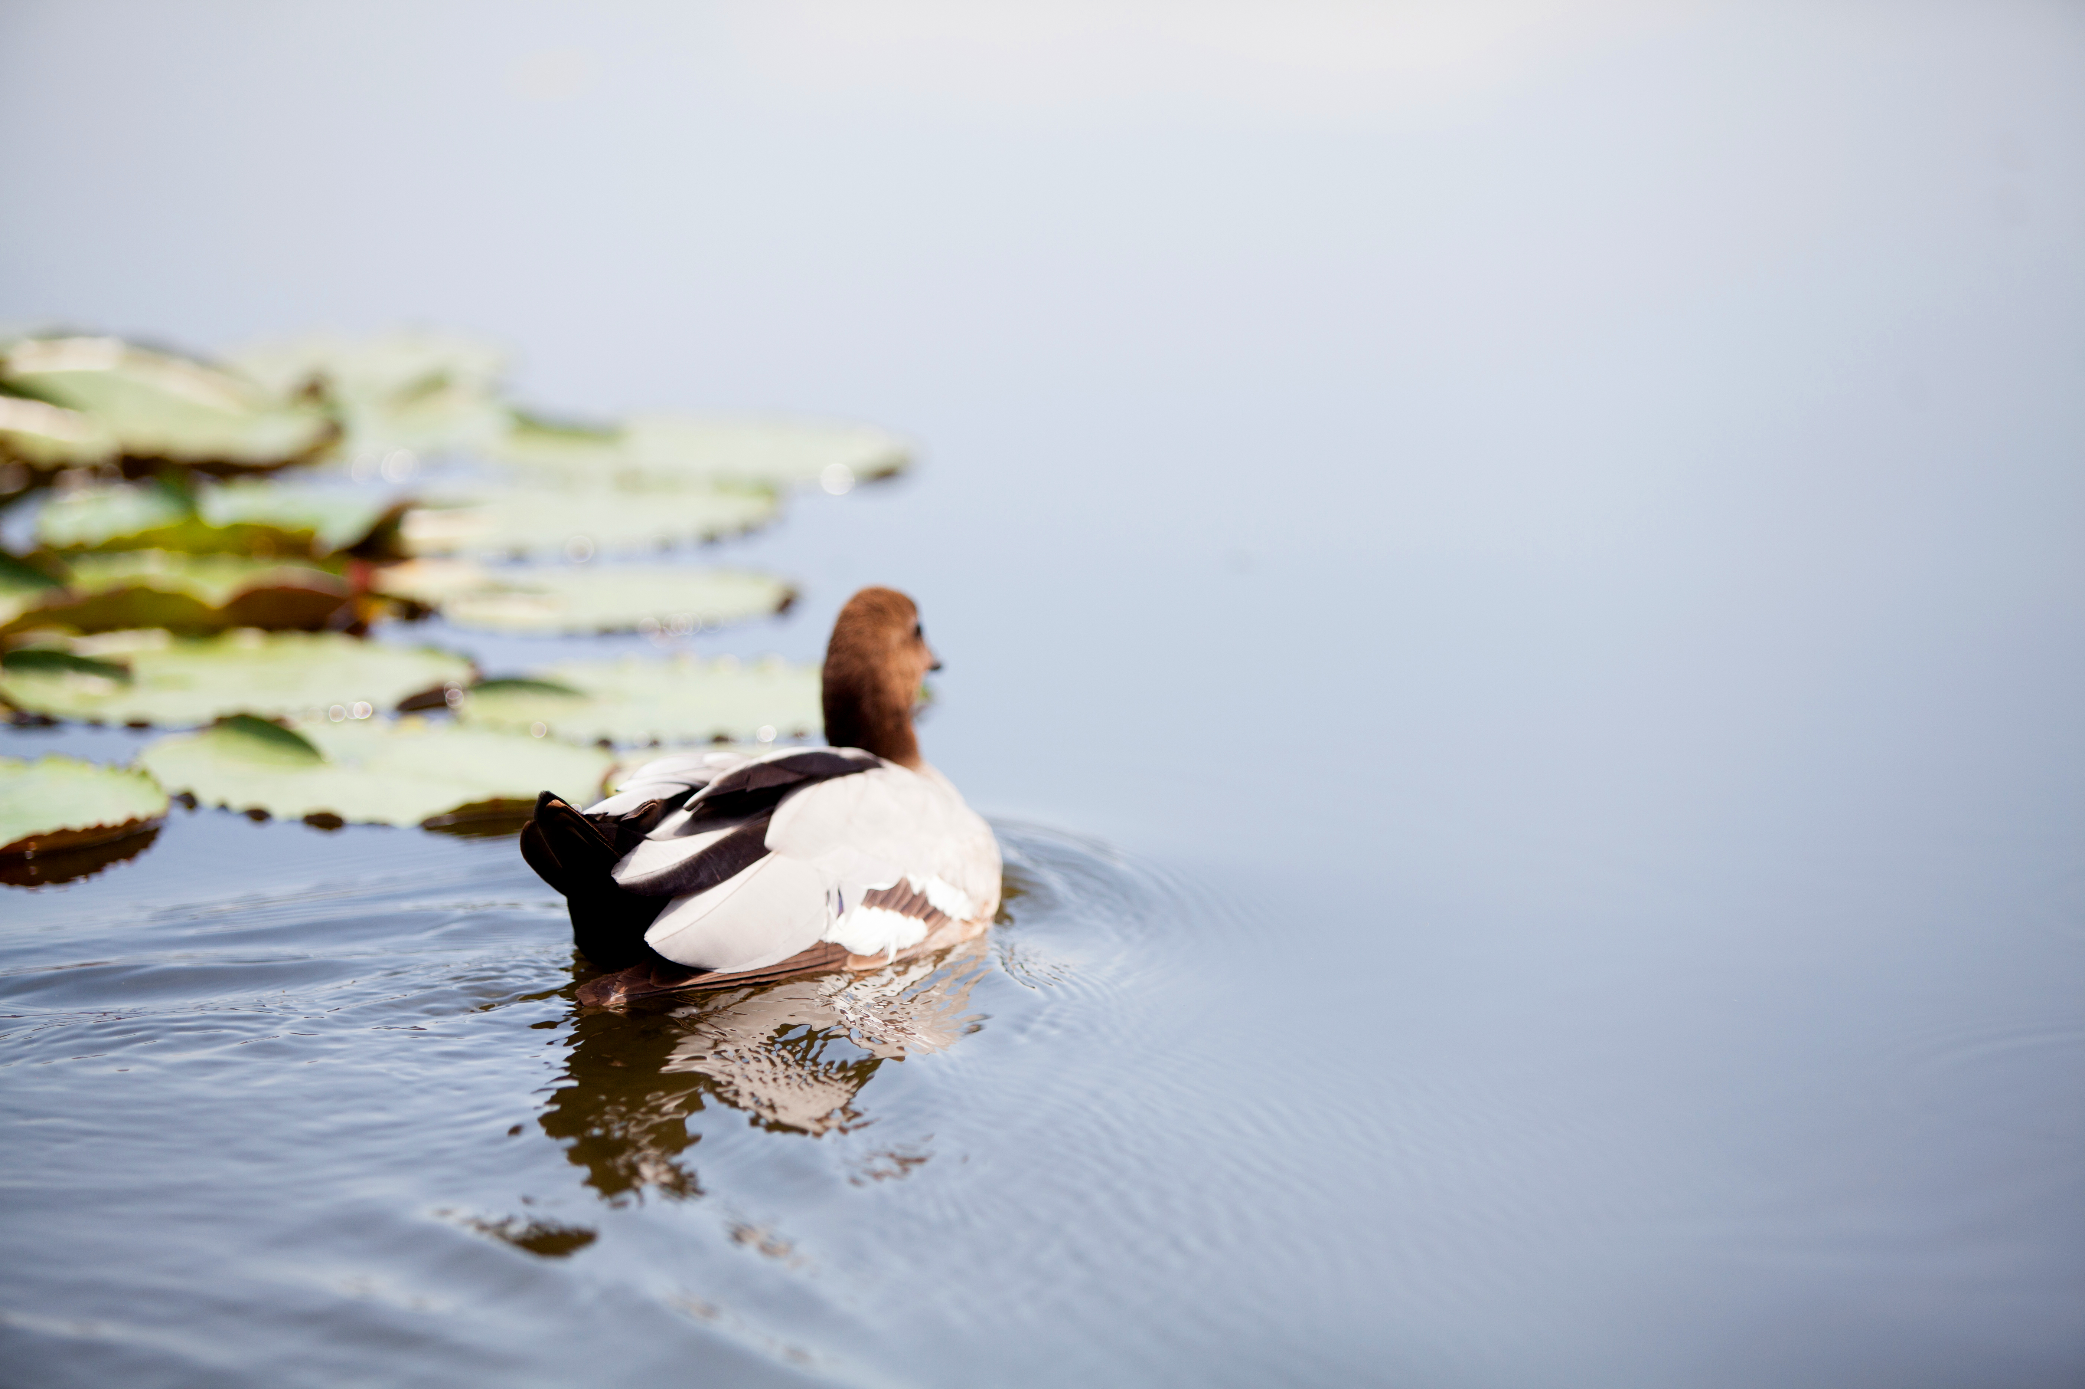
Example: Protecting the ecosystem when visiting
As the lake and surrounding ecosystem continues to establish, we encourage the UQ community to respect wildlife and the environment.
The lake is already home to many insects and animals including ducks, turtles and eels. It’s important not to feed or interact with them as this can disrupt their natural behaviours including foraging.
The lake is connected to local waterways and stormwater drains throughout the campus, so it’s important to dispose of rubbish and chemical waste correctly.
With the community’s help, the ecosystem will continue to thrive over time and remain a much-loved part of UQ’s St Lucia campus for years to come.
Source: UQ lake and amphitheatre renewal

Slide 9


Adjusted example: Protecting the ecosystem when visiting
As the lake and surrounding ecosystem continues to establish, we encourage the UQ community to respect wildlife and the environment.
With the community’s help, the ecosystem will continue to thrive over time and remain a much-loved part of UQ’s St Lucia campus for years to come.
The lake is already home to many insects and animals including ducks, turtles and eels. It’s important not to feed or interact with them as this can disrupt their natural behaviours including foraging.
The lake is connected to local waterways and stormwater drains throughout the campus, so it’s important to dispose of rubbish and chemical waste correctly.
Source: UQ lake and amphitheatre renewal & UQ Digital Asset Manager

