Slide 1
Student Leader Slides
Women in Engineering

Slide 2
Student Leader Slides
Tips:
Add your own notes to each slide, so you don’t need to memorise the whole presentation – we will print the slides for you prior to the event.
See Kathleen’s slides at the end for inspiration.
When adding photos from work sites, double check if you have permission for use.
Instructions
Thank you for sharing your story with us!
The following slides will be used in presentations to high school students, UQ events and industry partners. This is a great opportunity to show future engineers how is it like to study at UQ and improve your public speaking skills.
Feel free to add more content but stick to the UQ branding format. If you have any questions, let us know.
Kind regards,
Faculty of EAIT Marketing Team

Slide 3
Meet
Year
Program
Notes:
Introduce yourself (program and year) with 2 or 3 fun facts.
Some ideas:
What’s your dream job?
Favourite thing about engineering?
Why did you choose engineering?
What do you love doing in your spare time?
Do you have a unique/quirky fact or skill/talent?

Slide 4
My University Experience
University Life
Notes:
Tell us a bit about your experience at UQ.
Some tips:
How’s your timetable like? (add a screenshot if you can)
What are the main differences from high school?
What is your favourite place on campus?
Any tips for study/work/life balance?

Slide 5

Extracurricular
  Student societies I am part of:
    Women in Engineering
Notes:
What do you do outside classes?
Show pictures of your social life at UQ, hobbies, etc. If you are part of any student club or society, feel free to list them.

Slide 6

My Work Experience
Internships
Vacation Programs
Notes:
If you have work experience, use this slide to talk about it. List your internships, vacation programs or other types of work.

Slide 7
Extracurricular
Notes:
This is an alternative layout in case you don’t have many photos. Please delete this slide if unused.

Slide 8
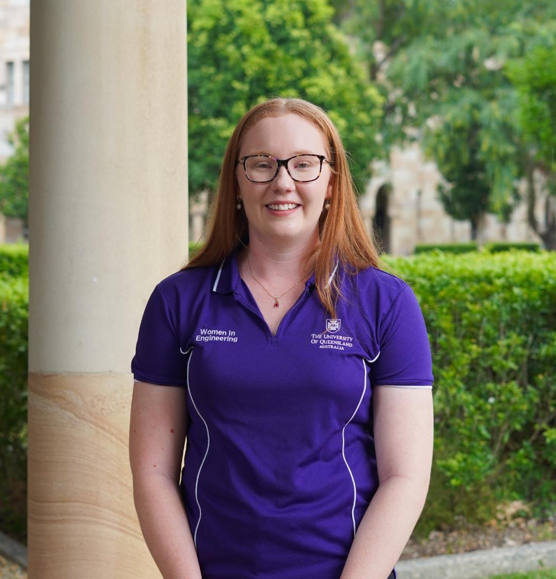
Meet Kathleen
Final Year
Bachelor of Engineering (Honours) /
Master of Engineering in Chemical
My dream job is to be a President or COO for a commodity within the mining industry. For now, it’s a FIFO based role as Process or Metallurgical Engineer where I can positively influence the direction of the industry.
My favourite thing about engineering is the people. I have met some of my greatest friends through engineering.
I took tap dancing lessons for 8 years!

Slide 9
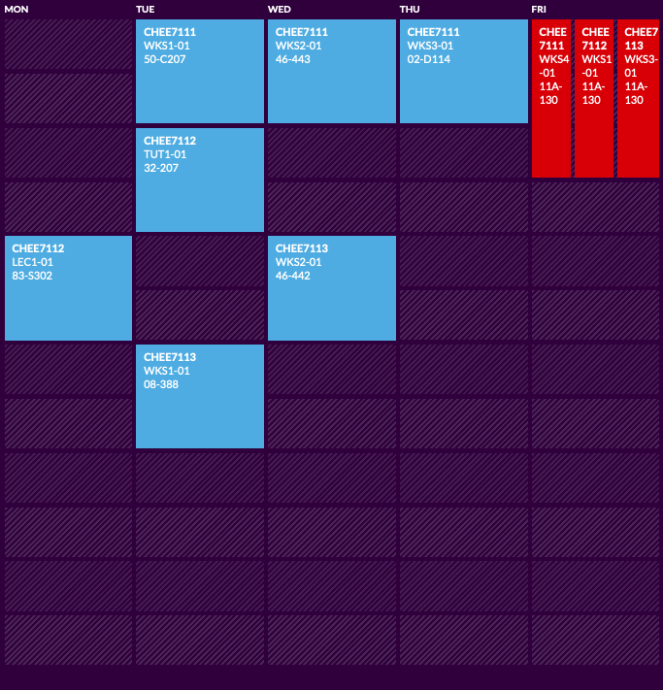
My University Experience
University Life
    Go to tutorials and workshops in person, there’s heaps of help available
    Get involved: clubs and societies have a variety of academic, social and industry events which is a great way to meet people, potentially someone who could offer you a job as well!
    The new Andrew N. Liveris Chemical Engineering Building is stunning and my favourite place to study on campus
    There are lots of vending machines on campus for late study night snacks
Notes:
You can decide if you want to do all your in-person classes on one day or spread them out across a few days
Your timetable gives you flexibility for a part time job
Remember to schedule in time to study around your classes
It is so important that you make time for yourself throughout uni as well, ask a new friend for coffee each week to break up your study routine
Do not underestimate the power of a good night's sleep!
Social sport and/or using the UQ sport facilities is a great way to stay active and healthy and as well as meet new people

Slide 10
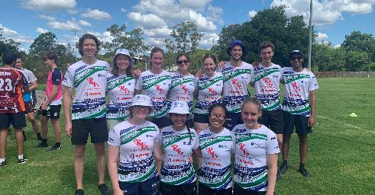
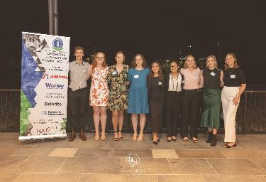
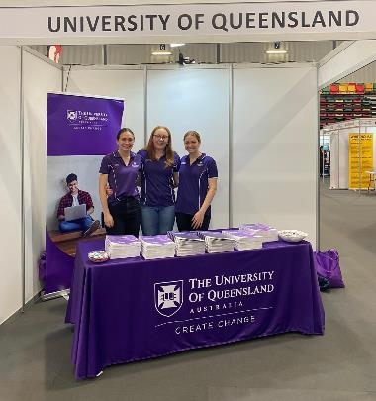
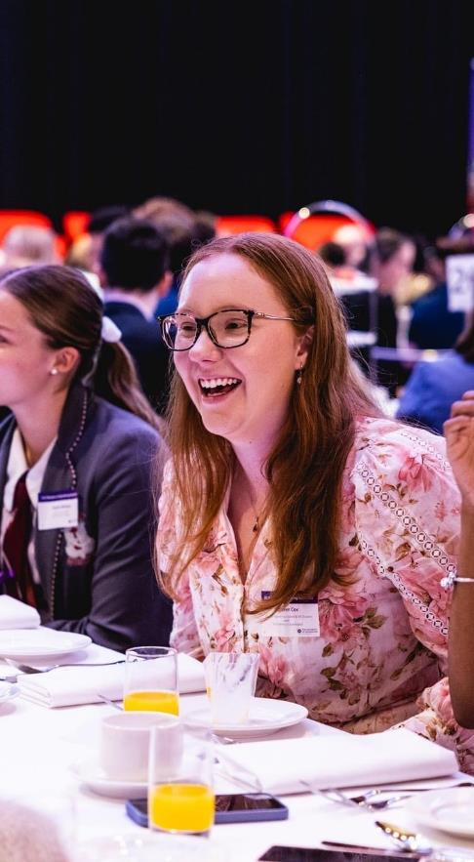
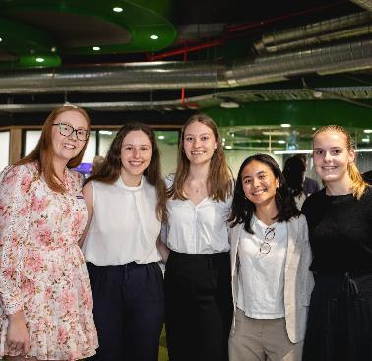
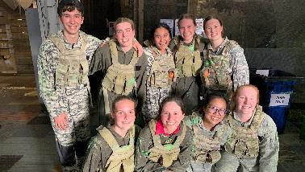
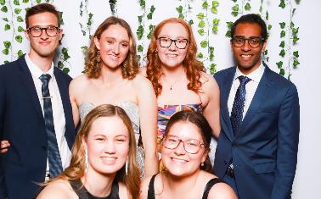
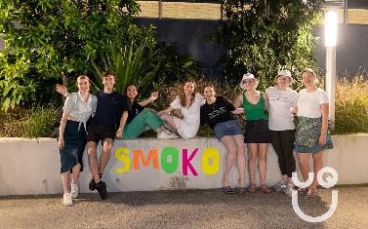
Extracurricular
  Student societies I am part of:
    Women in Engineering
    EUS (Engineering Undergraduate Society)
    ChESS (Chemical Engineering Student Society)
      2023 President
      2022 Secretary
    MAMA (Mining and Metallurgy Association)
    UQ SEN (Student Energy Network)
    Engineers Without Borders (EWB)
    Leaders@EAIT

Slide 11
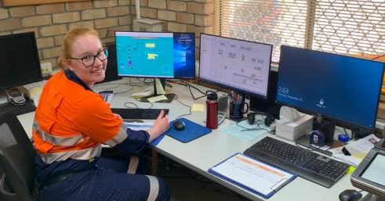
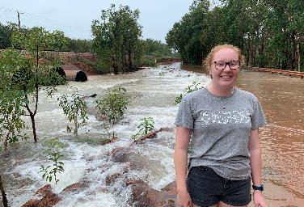
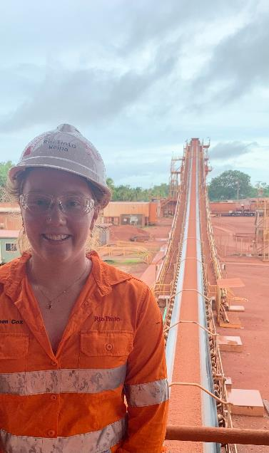
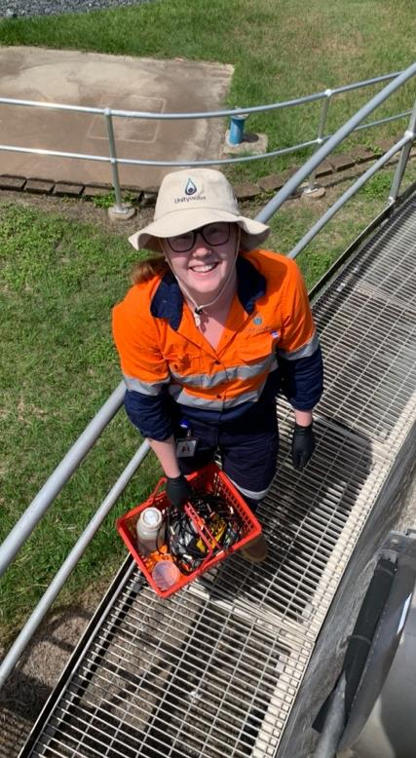
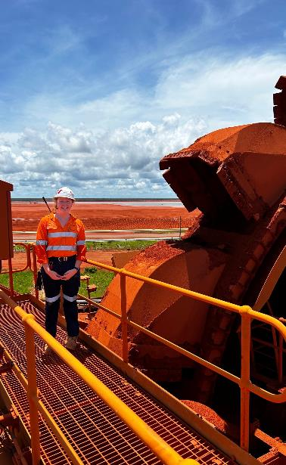
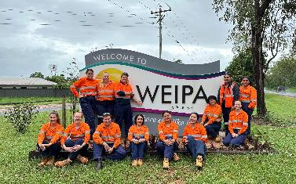
My Work Experience
Vacation Process Engineer with Unitywater
Vacation Process Engineer with Rio Tinto
Notes:
Vacation Process Engineer with Unitywater
Process data collection and analysis to understand the wastewater treatment plant operations and processes
Reviewed and updated Unity Process Guidelines and Standard Operating Procedures to understand compliant effluent quality
Literature review and oral presentation on PFAS (Per- and polyfluoroalkyl substances) including the latest development with the emerging contaminant
Conducted an optimisation and efficiency analysis on effluent pumps to understand the sizing design of pump systems
Vacation Process Engineer with Rio Tinto
Lived in Weipa for a 3 month residential placement
Reviewing process data and plant trends for the Andoom and East Weipa Beneficiation Plants
Solving ad-hoc problems as required by Operations and/or Maintenance teams
Assisting with month end reporting and reconciliation
Validating weekly downtime data and collaborating with mechanical and electrical maintenance teams to improve fixed plant performance

